Slide 1
Watercolor Painting with Polygons
Khan Mostafa
khan.mostafa@stonybrook.edu
Graduate Student, Computer Science
Stony Brook University

Slide 2
Based on Painting with Polygons: A Procedural Watercolor Engine by
Stephen DiVerdi
Radomı´r Mech
Aravind Krishnaswamy
Daichi Ito
IEEE TRANSACTIONS ON VISUALIZATION AND COMPUTER GRAPHICS, VOL. 19, NO. 5, [p. 723-735] MAY 2013

Slide 3
Outline
Watercolor and its features
Overview
Project timeline
Algorithm description
Application issues
Wrap up

Slide 4
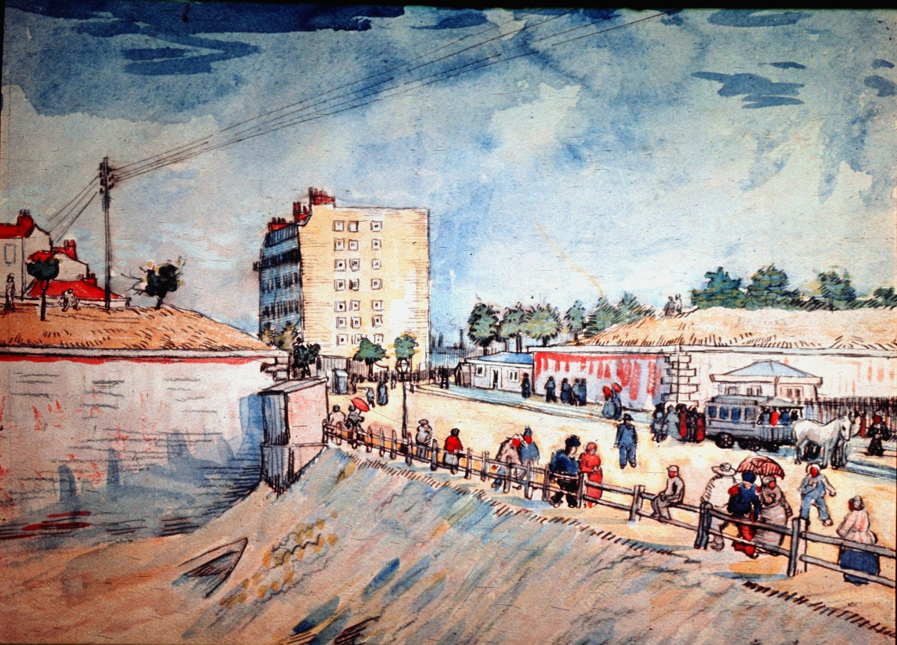
“Gate in the Paris Ramparts”
A famous watercolor by Van Gogh

Slide 5
Features of Watercolor
edge darkening
nonuniform pigment density
granulation
rewetting
back runs
color blending
feathering
glazing

Slide 6
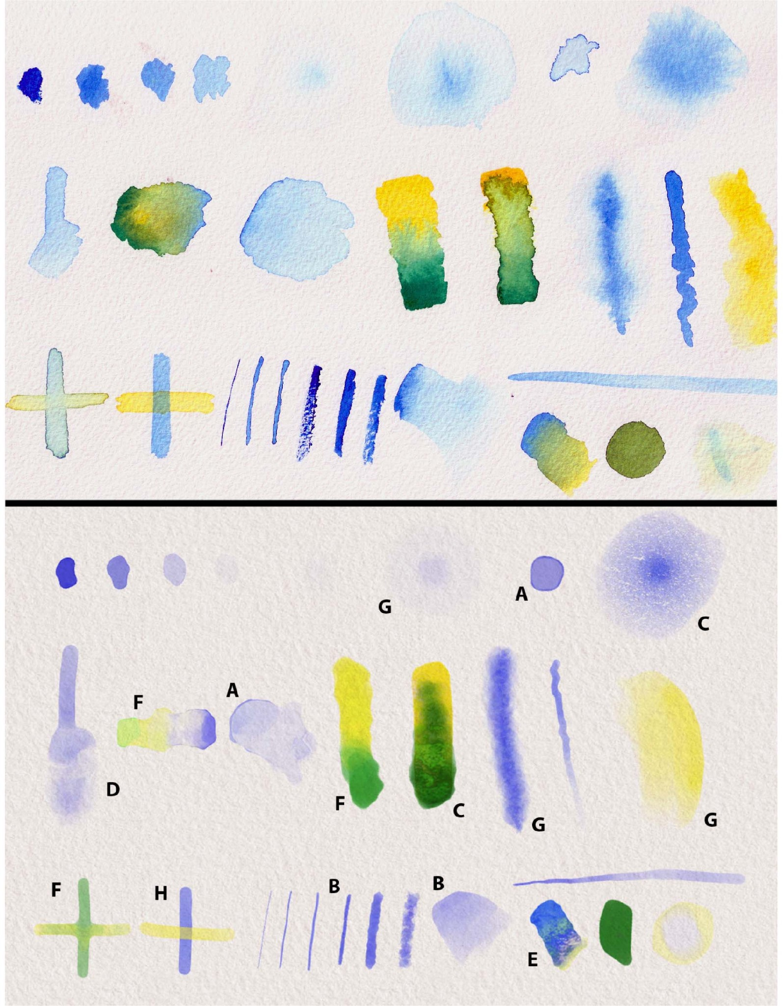
Features of Watercolor
Real watercolor strokes

Slide 7
Features of Watercolor
edge darkening
nonuniform pigment density
granulation
rewetting
back runs
color blending
feathering
glazing
Watercolor strokes in reference work

Slide 8
Advertisement
 | Others | DiVerdi et al | Advantage
Pigment flow | Gird based | Particle based | Reduced compute and space cost
Particle representation | Raster | Vector | Render at arbitrary resolution
Particle update |  | Procedural | Fast to compute
high-resolution output on low-powered devices
recreating interactive watercolor paint behaviors
edge darkening, nonuniform pigment density, granulation, back runs
Variety of brush types

Slide 9
Intuition
pixel grid-based simulations are dense
watercolor stroke effects are generally sparse
each particle in real watercolor paint can be thought of as taking a random walk, and the aggregate behavior is that of watercolor paint
sparse representation for paint pigment
a random walk algorithm to update each time step

Slide 10
Algorithm
Painting with Polygons: A Procedural Watercolor Engine

Slide 11
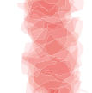
Representation/Model
Splats placed along
a stroke
complex polygon of n vertices
has own opacity value
rendered back to front
standard transparency blending

Slide 12
Algorithm
Paint Initialization
Pigment Advection
Sampling Management
Lifetime Management
Brush Types

Slide 13
Project Timeline
Week | Dates | Task
1 | 09/23~09/29 | Thorough reading and understanding of the paper
2,3 | 09/30~10/13 | Implementation of Paint Initialization and basic user interface
4,5 | 10/14~10/27 | Implementation of Pigment Advection
6 | 10/28~11/03 | Preparation for mid-term demo
7 | 11/04 | mid-term system demo
 | 11/5~11/10 | Implementation of Sampling Management
8,9 | 11/11~11/24 | Implementation of Lifetime Management
10 | 11/25~12/01 | User interface enhancement
11 | 12/02~12/05 | Submission preparation: report + software + presentation slide
 | 12/06 | Submission due

Slide 14
Paint Initialization
Stroke Input
Stroke to Collections of Stamps
Stamps to Splats
Splat rendering

Slide 15
Stroke Input
a stroke
regStrokePoint(int x, int y){
strokePt[strokePtIdx][0]=(float)(x-xmid)/RATIO;
strokePt[strokePtIdx][1]=(float)(ymid-y)/RATIO;
strokeCol[strokePtIdx] = currentCol;

Slide 16
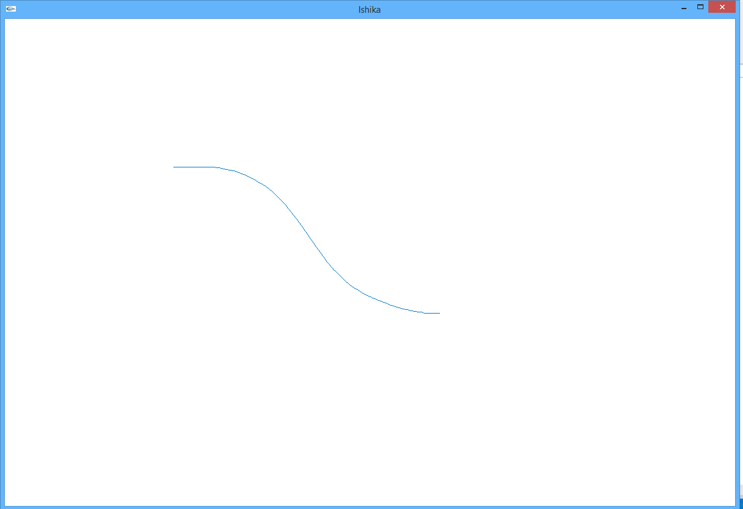
Stroke Input

Slide 17
Stroke to Stamps
σ = Stroke Sample Point distance
If (σ < stamp distance threshold)
advance a min distance
Else
interpolate

Slide 18
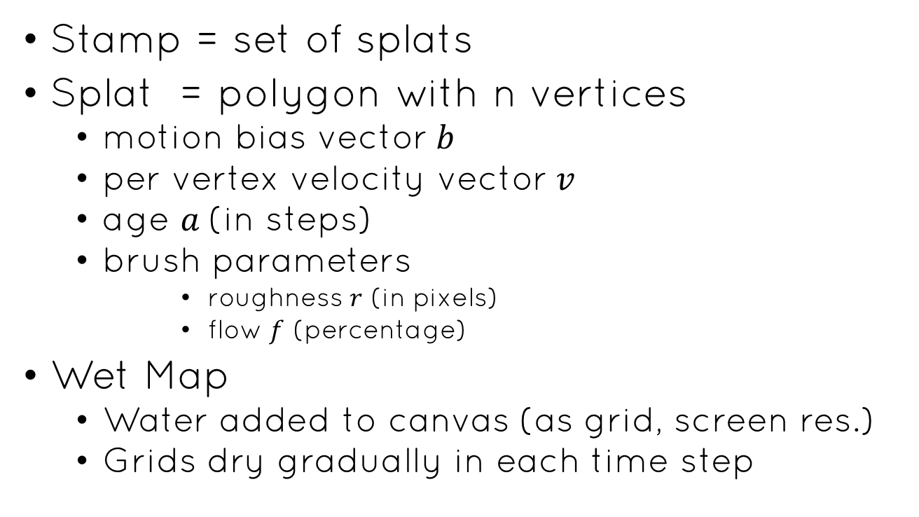
Splats
Stamp = set of splats
Splat = polygon with n vertices
motion bias vector$b$
per vertex velocity vector$v$
age $a$(in steps)
brush parameters
roughness $r$ (in pixels)
flow $f$ (percentage)
Wet Map
Water added to canvas (as grid, screen res.)
Grids dry gradually in each time step

Slide 19
Splats
struct SplatParamSt{
GLushort bx; //motion bias x
GLushort by; //motion bias y
GLushort a;//age
GLubyte r;//roughness [1~255px]
GLubyte f;//flow percentage [0-100]
GLubyte o;//opacity
}SplatParam[SPLATS];
GLfloat SplatVertex[SPLATS][N][DIM];
GLint SplactColor[SPLATS];
GLushort WetMap[WIDTH][HEIGHT];

Slide 20
Splats
Initial splat

Slide 21
Pigment Advection
Tuning parameter
Non-zero random <= 1+r
Global Gravity vector
Flow percentage
Update vertex to new position if new position is wet
Opacity recomputed to conserve amount of pigment

Slide 22
Pigment Advection on a Splat
After advection

Slide 23
Pigment Advection
Simulate biased random walk behavior of real water color
Random parameter provides randomness

Slide 24
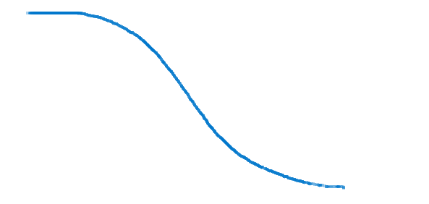
Stroke rendered as advected splats
(current implementation)

Slide 25
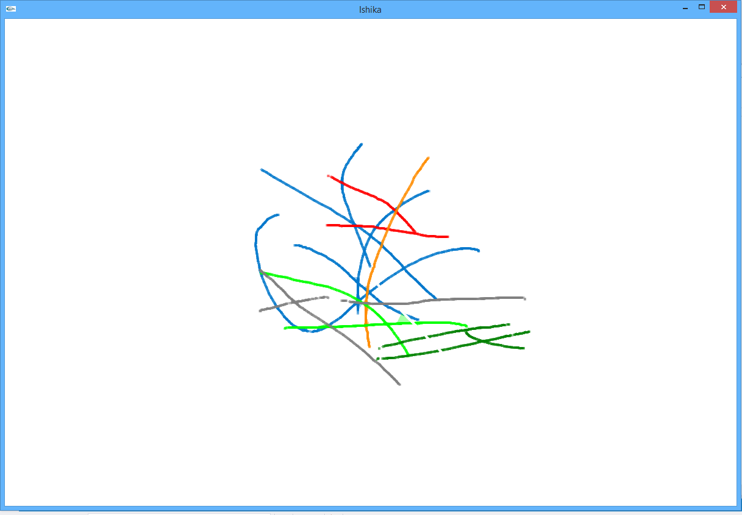
Several Strokes

Slide 26
Sampling Management
different advection directions
may create unrealistically straight hard edges
due to local undersampling
Deal this artifact:
Constrained vertex motion
Vertex can not move too far from its neighbor vertices of same splat
Periodic resampling of splat boundary
Compute total perimeter
Arc length per vertex
Vertices moved to uniform arc length

Slide 27
Sampling Management
After advection
Boundary resampling for uniform arc length

Slide 28
Sampling Management
Smoothing of splat boundary
Limits polygonal artifact
Constrained motion is fast but limits paint propagation
Boundary resampling is slower but achieve higher quality

Slide 29
Lifetime Management
Three stage of splat life
Flowing
When first added
Fixed
After a steps – splat stops being advected
Can be potentially rewetted to resume advection
Dried
After a period of not moving, permanently sainted
Rasterized into dry pigment buffer
Removed from simulation (reduce cost)

Slide 30
Lifetime Management
Water addition may rewet fixed splats
Simulates back runs and feathered edges
Rewetted vertex motion is set by water
As a splat dries granulation texture is applied

Slide 31
Brush types
Different arrangement of splat per stamp
Different brush parameter settings
Target width, w
Initial wet at wet map (=255)
Splat life (l= initial a)
Roughness, r
Flow, f

Slide 32
Sample Brushes
Initial splat configurations and resulting stroke for each brush
type.
Cyan outlines indicate the water region per-stamp. Black outlines indicate final splat shapes.
Total number
of splats in each stroke is also indicated
simple
wet on dry
wet-on-wet
blobby
crunchy

Slide 33
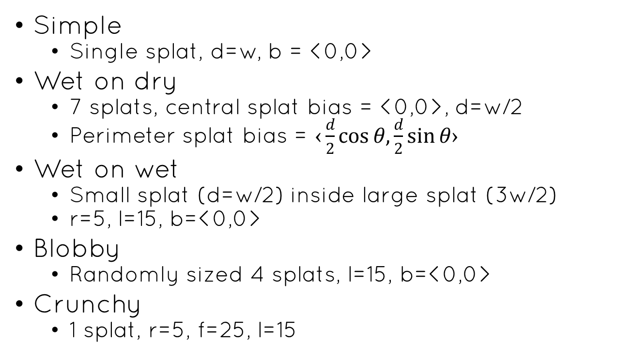
Sample Brushes
Simple
Single splat, d=w, b = <0,0>
Wet on dry
7 splats, central splat bias = <0,0>, d=w/2
Perimeter splat bias = $‹\frac{d}{2}\cos{θ,}\frac{d}{2}\sin{θ›}$
Wet on wet
Small splat (d=w/2) inside large splat (3w/2)
r=5, l=15, b=<0,0>
Blobby
Randomly sized 4 splats, l=15, b=<0,0>
Crunchy
1 splat, r=5, f=25, l=15

Slide 34
Application
Painting with Polygons: A Procedural Watercolor Engine

Slide 35
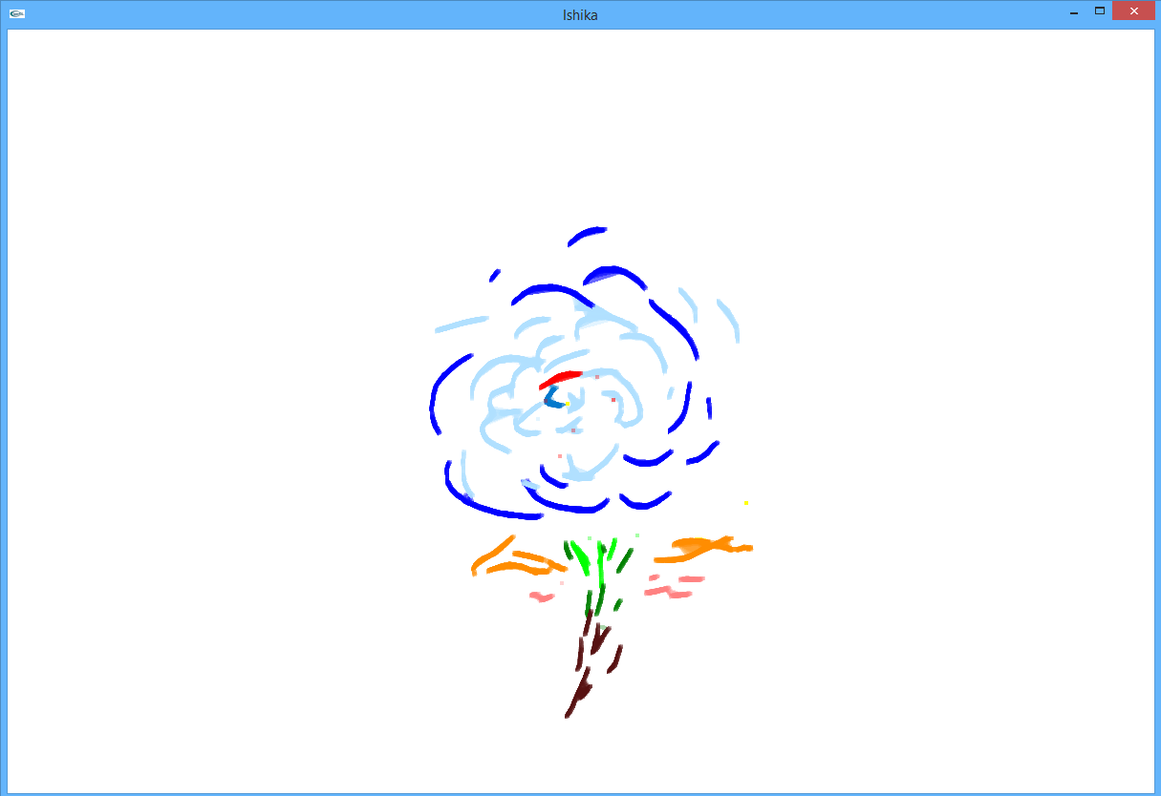

Slide 36
Interactive rendering
Two pass stencil buffer per splat
Anti aliasing
Full screen can be expensive
Post processing filter: adaptive per pixel blur
Darkened wet map

Slide 37
User Interface
Mid term demo interface has naïve interface
Can chose colors
Submission demo plans to include
Color palette
Brush selection
Brush sizes
Save and load drawn images

Slide 38
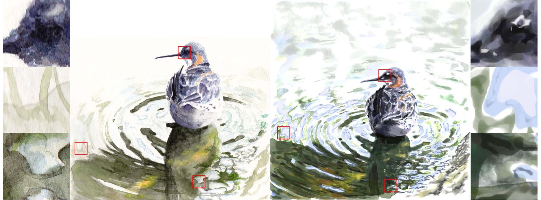
Comparison
Real watercolor drawing
Using reference app

Slide 39


Slide 40
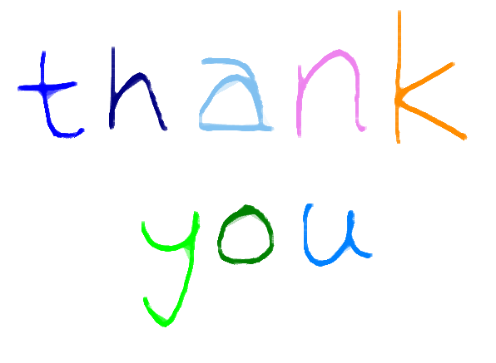
thanks

